Slide 1
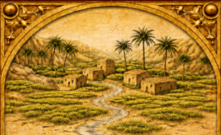
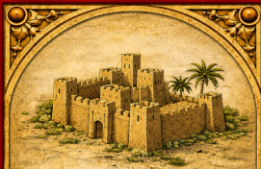
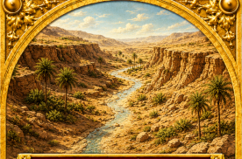
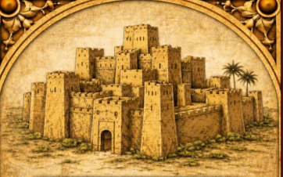
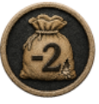
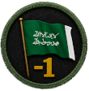
TERRAIN TYPE / ICON | TERRAIN VALUE / EFFECT
SETTLEMENT/ APPROACH | 1
STRONGHOLD | 3
RAVINE | 2
CITADEL | 4
SUPPLY | -2 Supply when captured
MORALE | -1 Morale when captured

Slide 2
SIEGE OF DIRIYAH
COMMAND POINT (CP) TABLE
ACTION | CP COST | EFFECT
INCREASE SUPPLY | 2 CP PER SUPPLY POINT | INCREASE SUPPLY BY PURCHASED AMOUNT
INCREASE MORALE | 2 CP PER MORALE POINT | INCREASE MORALE BY PURCHASED AMOUNT
ARTILLERY | 3 CP PER ARTILLERY CARD | PLACE MARKER(S) IN RESERVE; DEPLOY WHEN NEEDED; NEGATES ONE ARTILLERY ATTACK
INFANTRY | 1 CP PER INFANTRY POINT | DEPLOY INFANTRY MARKER(S) TO MAP OR RESERVE
COMMAND | 1 CP PER LEADER | DEPLOY LEADER(S) TO MAP OR RESERVE
FORTIFICATIONS | 4 CP PER SIEGE LEVEL | INCREASE SIEGE LEVEL OF SPACE (UP TO MAX 4)
TRENCHES | 1 CP PER TRENCH MARKER | DEPLOY TRENCH MARKER TO ANY SPACE
COUNTER-MINING | 1 CP PER 2 MARKERS | PLACE IN RESERVE; DEPLOY WHEN NEEDED; NEGATES OTTOMAN MINING
BREACH REPAIR | 3 CP PER MARKER | PLACE IN RESERVE; DEPLOY WHEN NEEDED; NEGATES BREACH
COUNTER-TUNNELING | 1 CP PER 2 MARKERS | PLACE IN RESERVE; DEPLOY WHEN NEEDED; NEGATES OTTOMAN TUNNELS
LOGISTICS
MILITARY
ENGINEERING

